Slide 1
Coursera Capstone IBM Applied Data Science Capstone Opening a New Bakery in Vancouver, BC
Parisa Shiri
August 2019

Slide 2
Business Problem
Bakeries are among favorite food place location for both locals and tourists in Vancouver. Location for opening a new bakery is one of the most important decisions that will determine whether the bakery will be a success.
Objective: To analyse and select the best locations in Vancouver, BC to open a new bakery
Business Question: In Vancouver, if an investor is looking to open a new bakery, where would you recommend that they open it?

Slide 3
Data
List of neighbourhoods in Vancouver with their geospatial coordinates
Venue data, particularly data related to bakeries and their locations
Sources of data
For list of neighborhoods in Vancouver and their coordinates:
https://data.vancouver.ca/datacatalogue/localAreaBoundary.htm
For venue and bakery data:
https://developer.foursquare.com (via developer free account)

Slide 4
Methodology
Converting the KML file containing neighborhood information to geojson, then loading it in jupyter notebook and populating it in a pandas dataframe
Cleaning the data, the list for corners of each neighborhood is given, the latitudes and longitudes are averaged to represent each neighborhood with only one point
Use Foursquare API to get venue data
Group data by neighbourhood and taking the mean of the frequency of occurrence of each venue category
Filter venue category by Bakery
Perform clustering classification using k-means clustering
Visualizing the clusters in a map using Folium

Slide 5
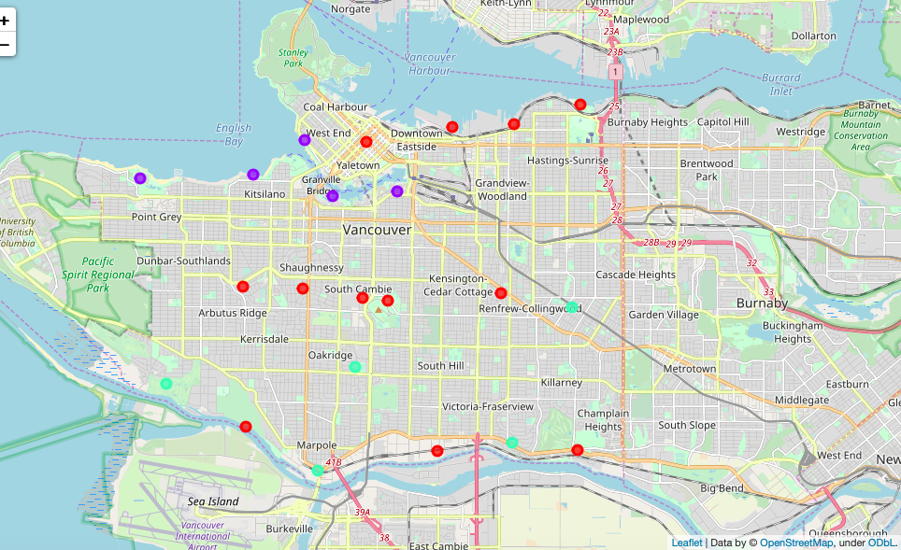
Results
Categorized the neighbourhoods into 3 clusters:
Cluster 0: Neighbourhoods with moderate number of bakeries (in red)
Cluster 1: Neighbourhoods with high number of bakeries (in purple)
Cluster 2: Neighbourhoods with low concentration of bakeries (in mint green)

Slide 6
Discussion
Most of the bakeries are concentrated in the central area of the city
Highest number in cluster 1 and moderate number in cluster 0
Cluster 2 has very low number to no bakeries in the neighbourhoods
Oversupply of bakeries mostly happened in the northern and downtown areas of the city, with the southern areas having very few bakeries

Slide 7
Recommendations
Open new bakery in neighbourhoods in cluster 2 with little to no competition
Another option is to open the new bakery in neighbourhoods in cluster 0 with moderate competition if unique selling propositions can be provided to stand out from the competition
Avoid neighbourhoods in cluster 1, already high concentration of bakeries and intense competition

Slide 8
Conclusion
The neighbourhoods in cluster 2 are the most preferred locations to open a new bakery
Findings of this project will help the relevant stakeholders to capitalize on the opportunities on high potential locations while avoiding overcrowded areas in their decisions to open a new bakery

Slide 9
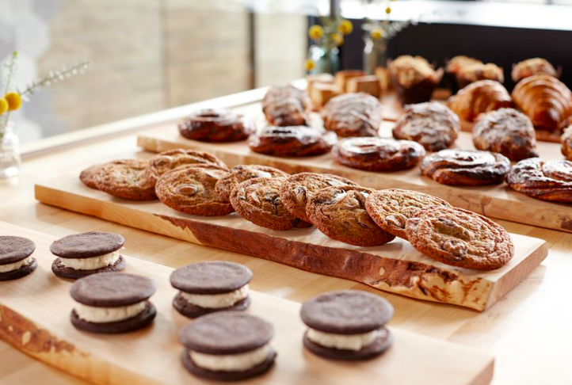
Thank you

